Slide 1
FPROG Project
TextAnalytics
David Höchtl, Maximilian Mörth, Armin Islamovic
Notes:
Armin

Slide 2
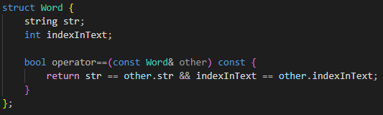
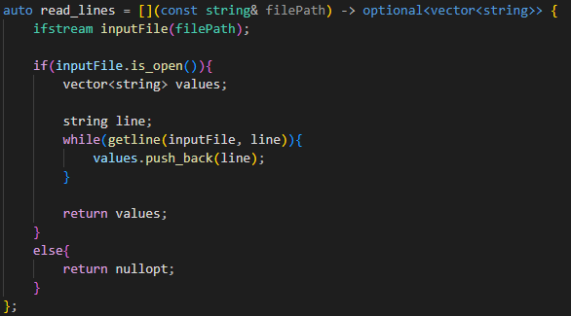
Read files
Notes:
Armin

Slide 3
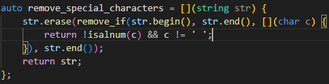
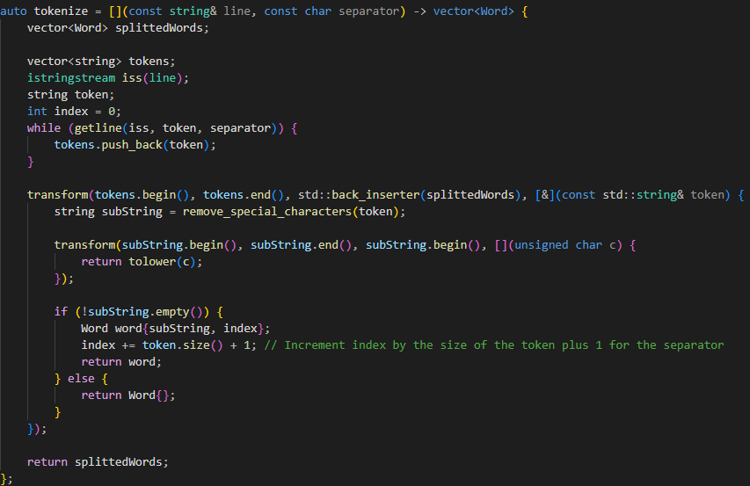
Tokenize the text
Notes:
David

Slide 4
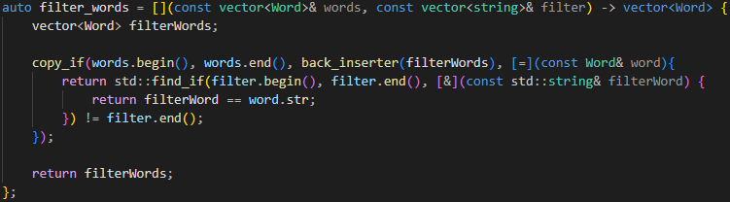
Filter words
Notes:
David

Slide 5
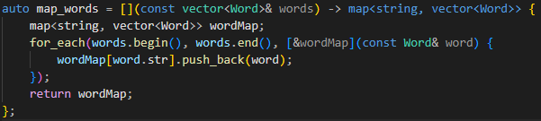

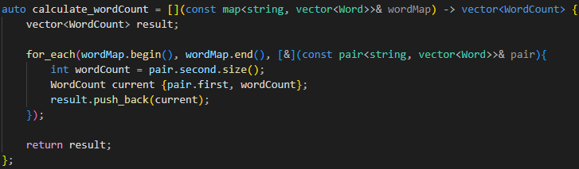
Count word occurrences
Notes:
David

Slide 6
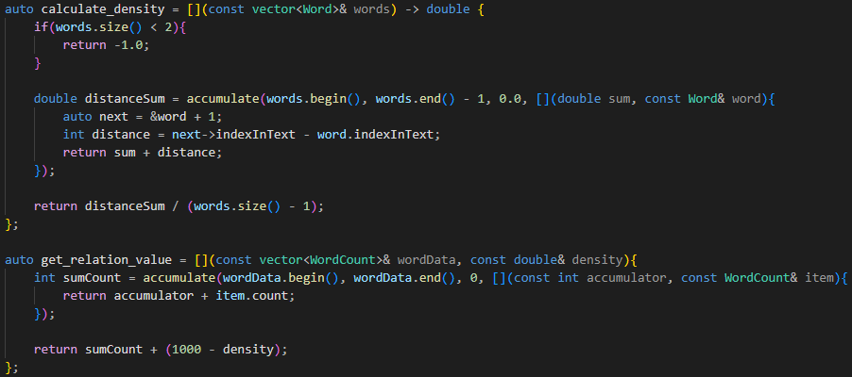
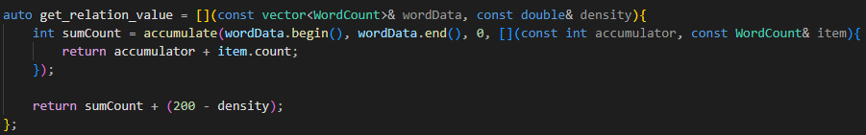
Calculate term density
Notes:
David

Slide 7
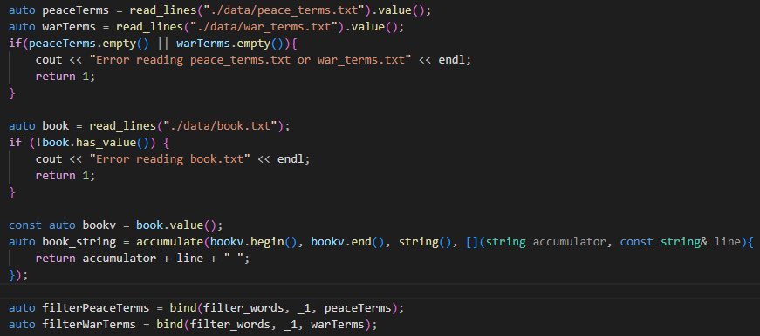
Main Methode
Notes:
Max

Slide 8
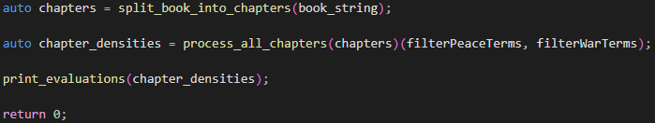
Main Method
Notes:
Max

Slide 9
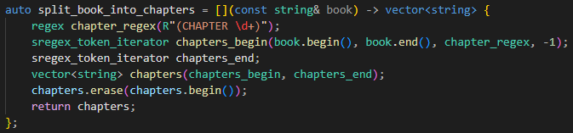
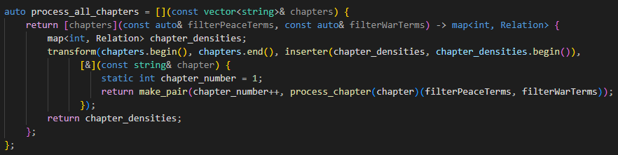
Process chapters
Notes:
Max

Slide 10
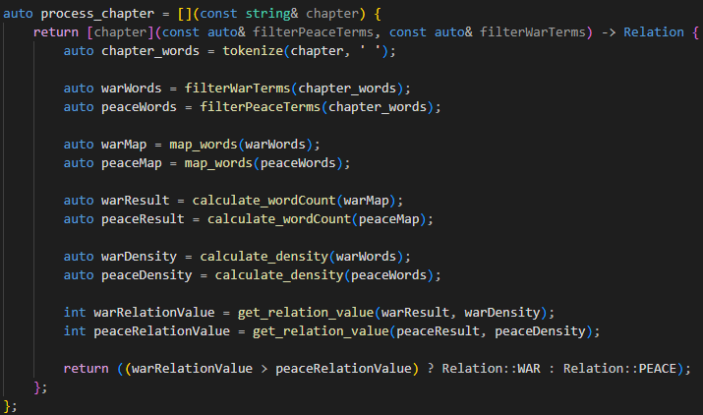

Process Chapter & categorize chapters
Notes:
Max

Slide 11
Danke für Eure Aufmerksamkeit

